Slide 1
Summarization Patterns - Inverted Index
CSC 4760 / 6760 Big Data Programming
Spring 2020

Slide 2
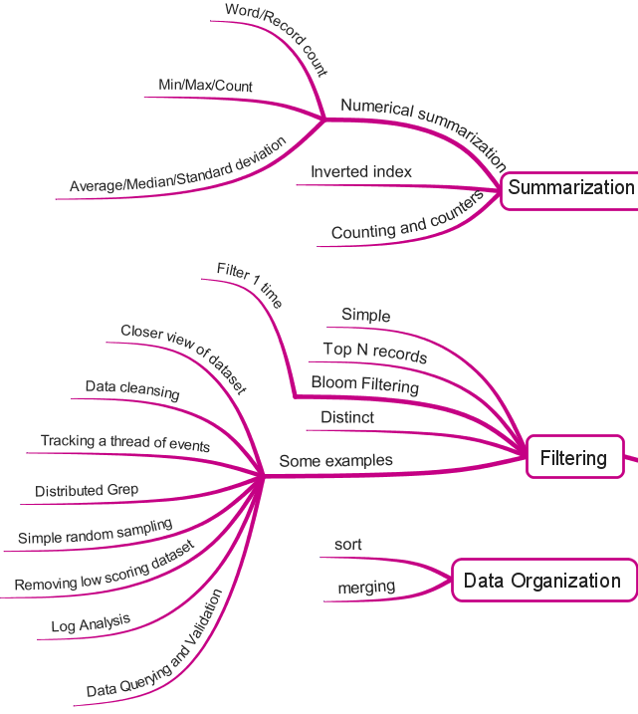
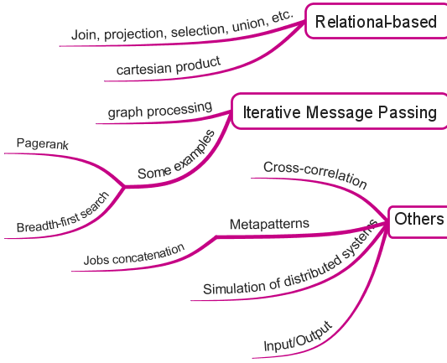
MapReduce Design Patterns
Contents Summary

Slide 3
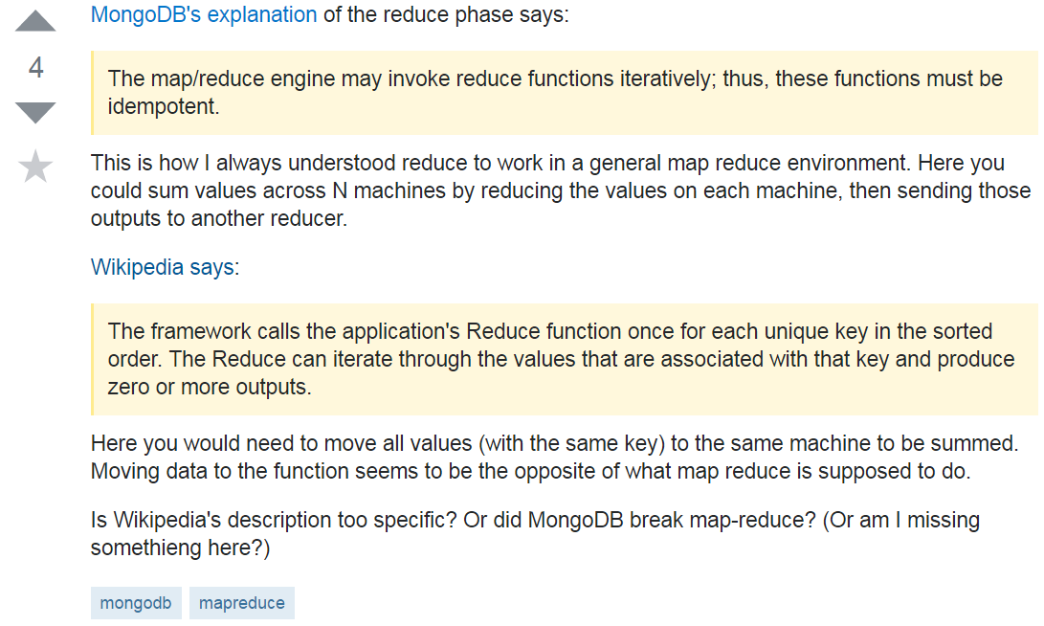
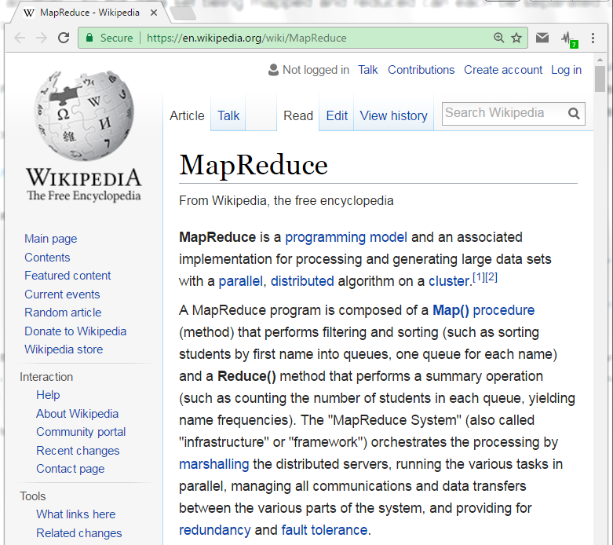
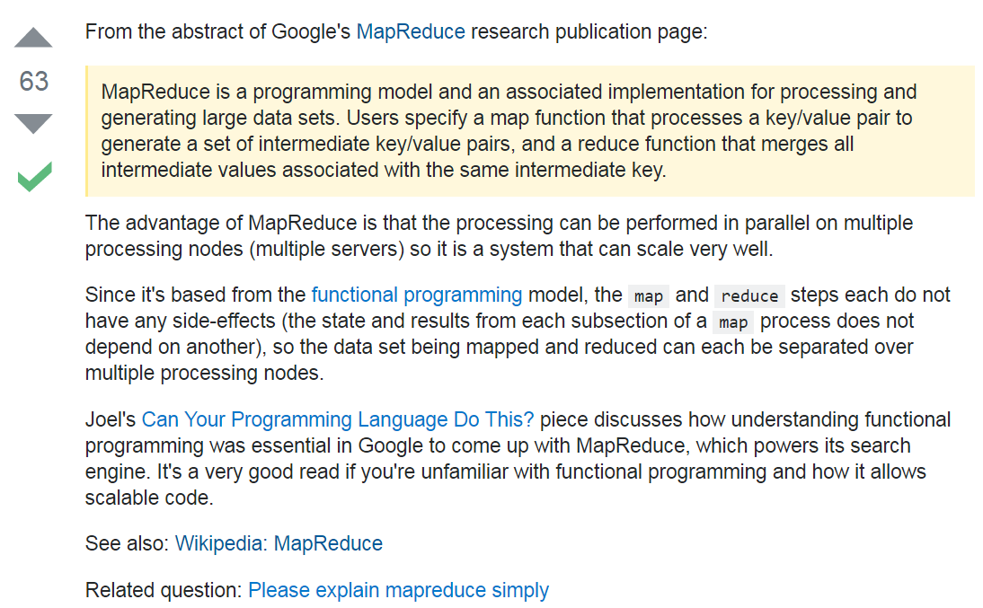
1) http://stackoverflow.com/questions/12956892/is-wikipedias-explanation-of-map-reduces-reduce-incorrect
2) http://stackoverflow.com/questions/388321/what-is-map-reduce

Slide 4
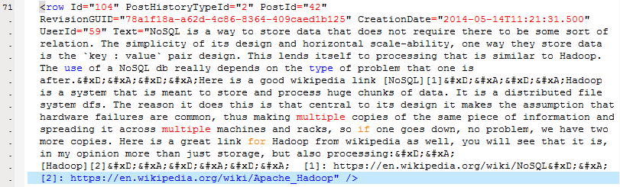
Problem to be Solved
We want to add StackOverflow links to each Wikipedia page that is referenced in a StackOverflow comment.
Given a list of user’s comments, determine
Build an inverted index of Wikipedia URLs to a set of answer post IDs

Slide 5
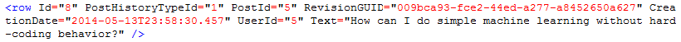
Parsing the XML file
Key (String) | Value (String)
Id | 8
PostHistoryTypeId | 1
PostId | 5
RevisionGUID | 009bca93-fce2-44ed-a277-a8452650a627
CreationDate | 2014-05-13T23:58:30.457
UserId | 5
Text | How can I do simple machine learning without hard-coding behavior?

Slide 6
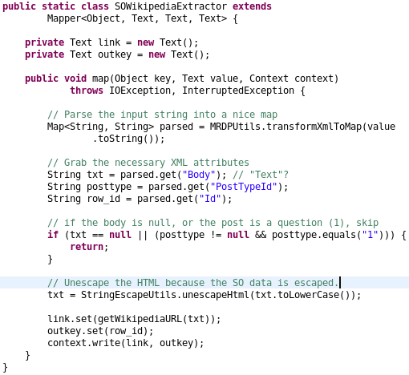
Mapper
import org.apache.commons.lang.StringEscapeUtils;
static String unescapeHtml(String str)
Unescapes a string containing entity escapes to a string containing the actual Unicode characters corresponding to the escapes.
"&lt;Fran&ccedil;ais&gt;"
"<Français>"
Source code “WikipediaIndex.java”

Slide 7
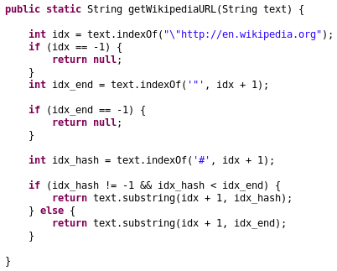
Function to Extract URL
https://en.wikipedia.org/wiki/Least_squares#Lasso_method
https://en.wikipedia.org/wiki/Least_squares
https://en.wikipedia.org/wiki/Comma-separated_values#Example
https://en.wikipedia.org/wiki/Comma-separated_values
Source code “WikipediaIndex.java”

Slide 8
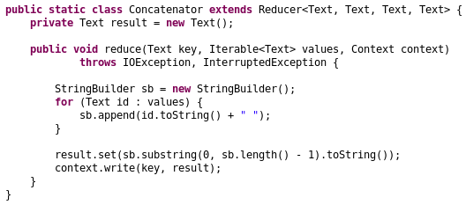
Reducer
Reducer can be used as the Combiner
Source code “WikipediaIndex.java”

Slide 9
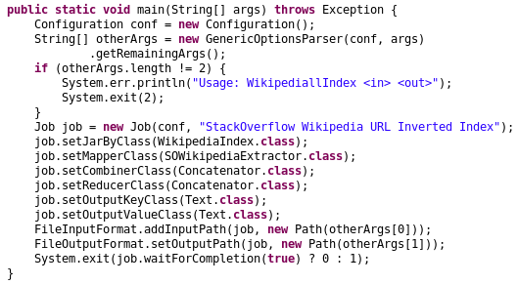
main function
Source code “WikipediaIndex.java”

Slide 10
Inverted Index Summarizations
Generate an index from a dataset to allow for faster searches or data enrichment capabilities
It is often to index large datasets on keywords. The searches can trace terms back to records that contain specific values.
Building an inverted index can greatly reduce the amount of time to find something even though it requires extra time to build this index.
If there is no inverted index, we have to scan the whole dataset once for each query

Slide 11
Applicability of Inverted Index Summarizations
Inverted indexes should be used when quick search query responses are required. The results of such a query can be preprocessed and ingested into a database.
Google Search Engine
The Search Engine knows all the web pages related to a keyword ahead of time. These results are simply displayed to the user.

Slide 12
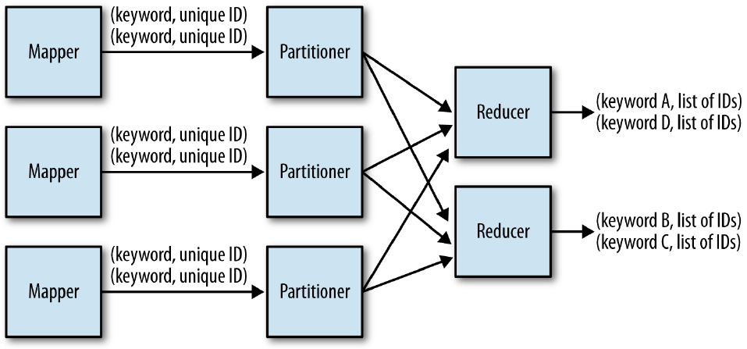
The structure of the inverted index pattern
Figure 2-5, MapReduce Design Patterns

Slide 13
Partitioner
Responsible for determining where values with the same key will eventually be copied by a reducer for final output.
It can be customized for more efficient load balancing if the intermediate keys are not evenly distributed.

